Slide 1
CPBP 8306: Data cleaning day 2
Stevenson Science & Engineering Library
Joshua Borycz

Slide 2
Wide vs long data

Slide 3
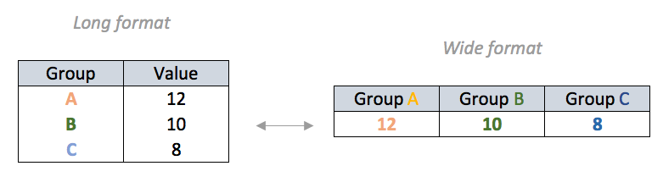
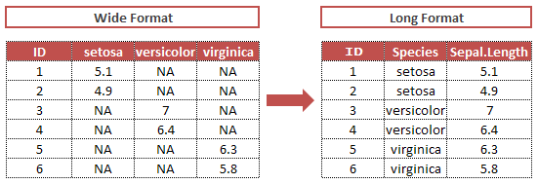
Tidy data transforms “wide format” data into “long format” data
Notes:
When you structure your data into tidy format your table will become longer than it used to be
This is an expected consequence and often a visual identifier
However, the content within the table remains the same, only structured differently.
Benefit is that tidy format allows for easy transformations of other tables.
you can convert your data into any framework for whatever you need.

Slide 4
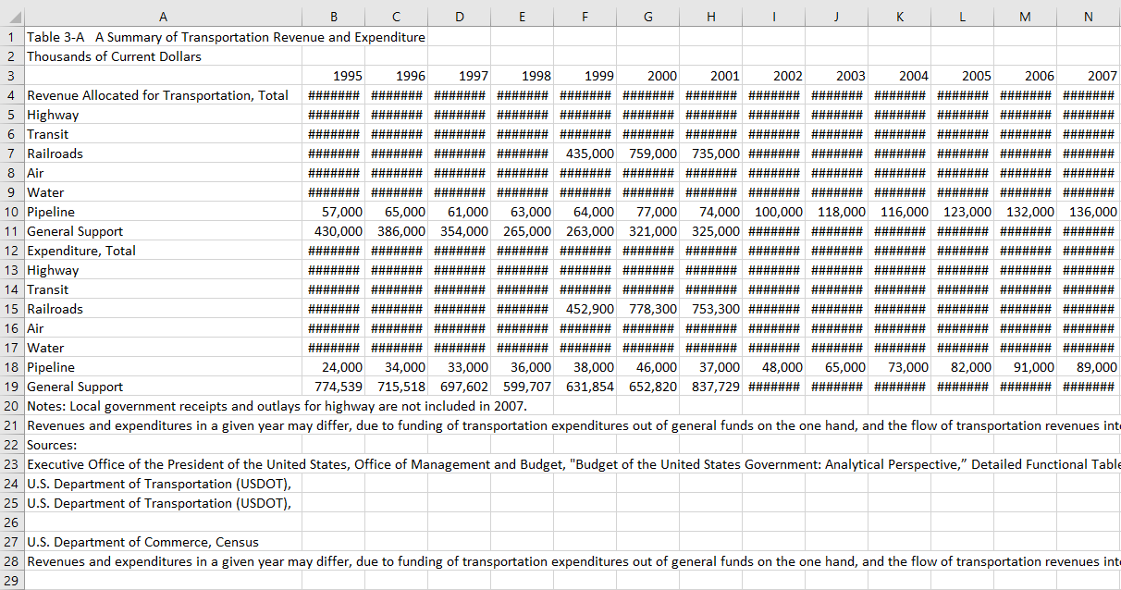
Let’s critique this untidy data table together
Notes:
Government Transportation Financial Statistics (GTFS) 2007 from the U.S Department of Transportation
GTFS provides the public with information on transportation-related revenue and expenditures for all levels of government (i.e., federal, state, and local), and for all modes of transportation (i.e., highway, transit, railroads, air, water, pipeline, general support)
For analysis purposes, this is not the best form to save your data in.
General Issues:
Data file contains contextual information that would break the data (e.g., Title, metadata, notes)
Best Practice Tip: For data to be machine readable and interoperable, it should. have only two types of rows: a single header row, and all other rows are data.
Minor: data types saved as string (pound symbol in excel = str cell)
For presentation purposes this works. Understandable for humans

Slide 5
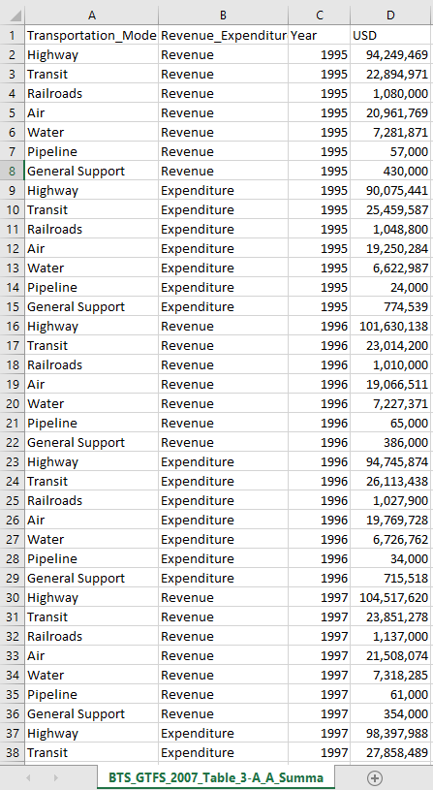
Transformed into long, tidy data
Removed everything that isn’t data:
Annotations, notes, explainers
Aggregation functions (e.g., Sum/Total)
Converted “Year” into a variable
Messy data “column headers are values, not variable names”
Tidy Data have two types of rows:
a single header row
data rows
Notes:
Note: We have only restructured the data and removed non data content (e.g., title and descriptions)
The data still contains the same number of cells, but now facilitates machine analysis
Good practice to only include data in your data file and all other contextual information should be addressed in other locations (e.g., ReadMe, data dictionary)

Slide 6
Joining data

Slide 7
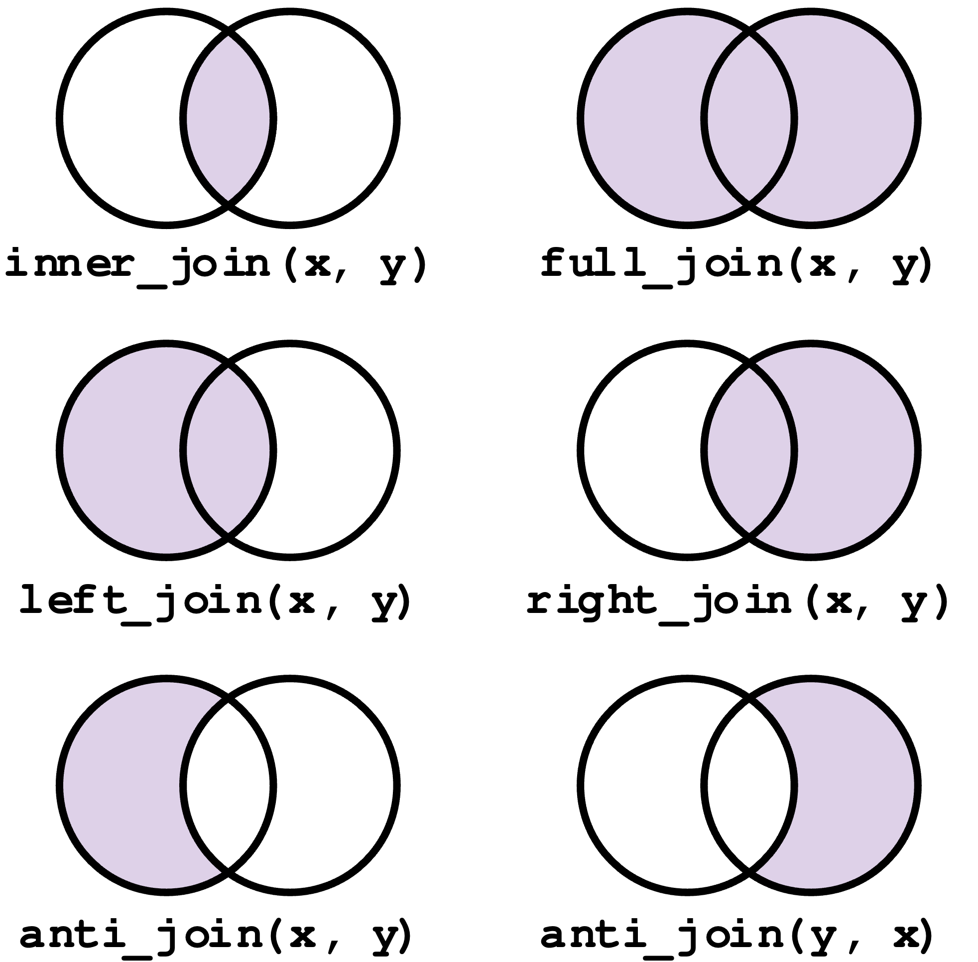
Joining data using dplyr
left_join(): Joins two tables based on common columns, keeping all rows from the left (first) table and matching rows from the right (second) table.
right_join(): Joins two tables based on common columns, keeping all rows from the right (second) table and matching rows from the left (first) table.
inner_join(): Joins two tables based on common columns, keeping only the rows that have matches in both tables.
full_join(): Joins two tables based on common columns, keeping all rows from both tables.
semi_join(): Keeps all rows from the left (first) table where there is a match in the right (second) table.
anti_join(): Keeps all rows from the left (first) table where there is no match in the right (second) table.
Notes:
Note: We have only restructured the data and removed non data content (e.g., title and descriptions)
The data still contains the same number of cells, but now facilitates machine analysis
Good practice to only include data in your data file and all other contextual information should be addressed in other locations (e.g., ReadMe, data dictionary)

Slide 8
Some cool data

Slide 9

World values survey
Global research project exploring people's values and beliefs
Covers topics such as economic development, democracy, religion, gender equality, and social capital
Investigates how they change over time and what social and political impact they have (seven waves of surveys since 1981)
Conducted in nearly 100 countries, representing over 90% of the global population
Common questionnaire with face-to-face interviews
Provides insights for governments, NGOs, and businesses on cultural shifts and societal trends
Notes:
we’ll demonstrate how to set up search alerts for queries in databases
Also run through a few searches in these
Mostly focusing on SciFinder

Slide 10
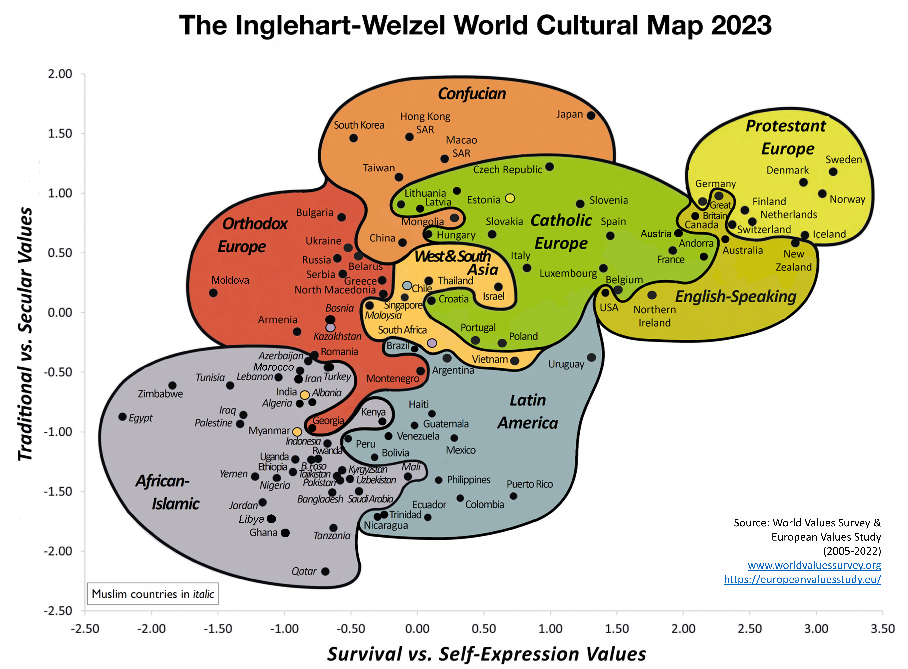
World values survey
Notes:
we’ll demonstrate how to set up search alerts for queries in databases
Also run through a few searches in these
Mostly focusing on SciFinder

Slide 11
Cultural data
9 cultural factors were derived from the World Value Survey and European Values Survey through Principal Component Analysis
Secular-rationality
Institutional confidence
Openness to in-groups
Prosociality
Interest in politics
Wellbeing
Political engagement
Individual rights
Openness to out-groups
Notes:
we’ll demonstrate how to set up search alerts for queries in databases
Also run through a few searches in these
Mostly focusing on SciFinder

Slide 12
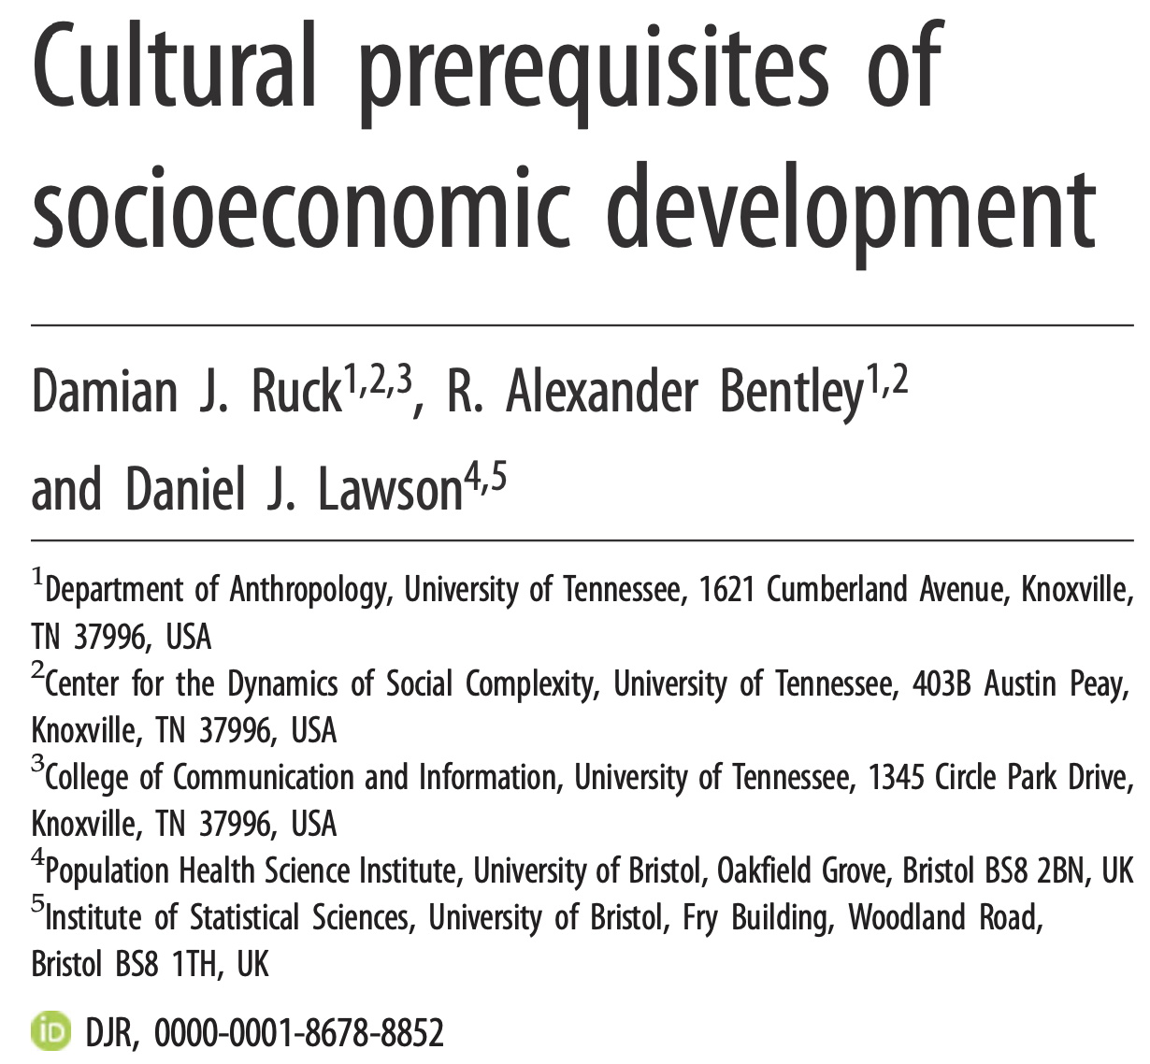
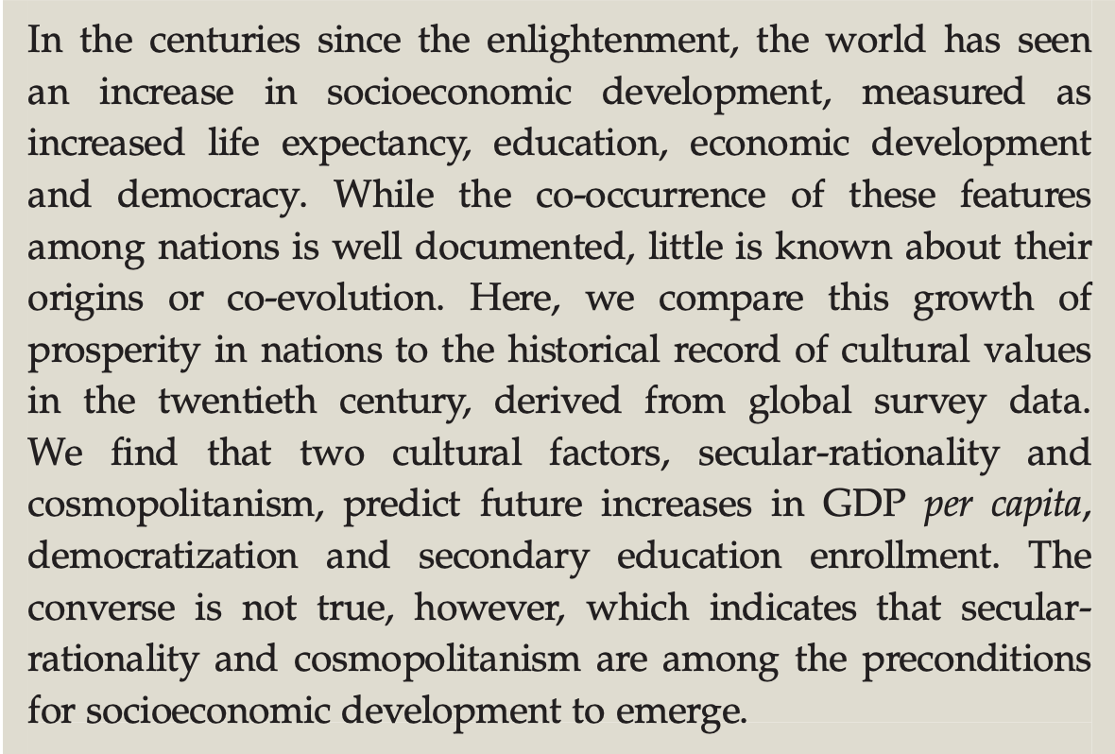
Cultural data
https://royalsocietypublishing.org/doi/full/10.1098/rsos.190725
Notes:
we’ll demonstrate how to set up search alerts for queries in databases
Also run through a few searches in these
Mostly focusing on SciFinder

Slide 13
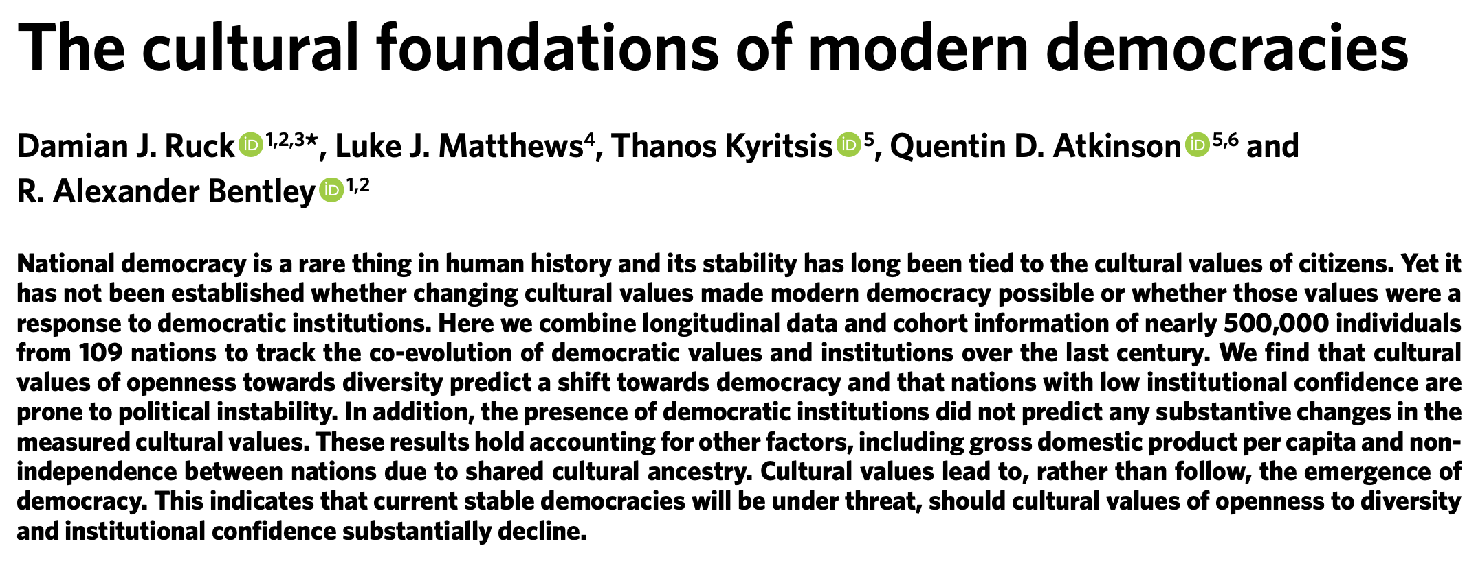
Cultural data
https://www.nature.com/articles/s41562-019-0769-1
Notes:
we’ll demonstrate how to set up search alerts for queries in databases
Also run through a few searches in these
Mostly focusing on SciFinder

Slide 14
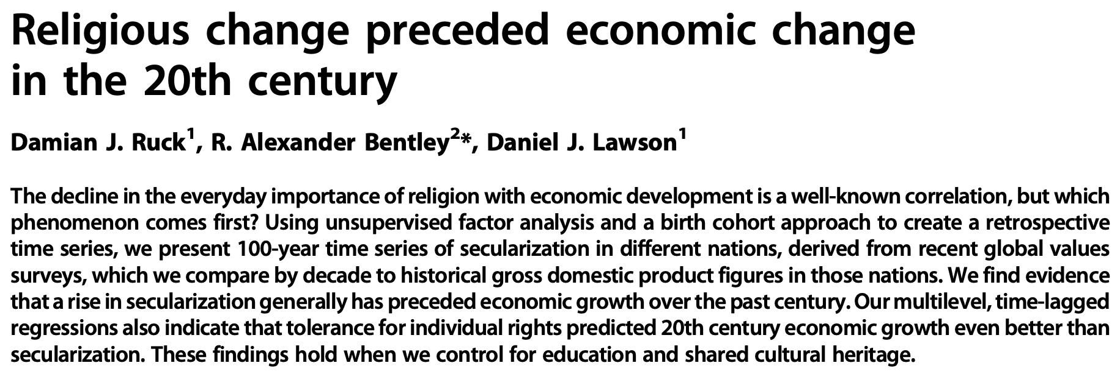
Cultural data
https://www.science.org/doi/full/10.1126/sciadv.aar8680
Notes:
we’ll demonstrate how to set up search alerts for queries in databases
Also run through a few searches in these
Mostly focusing on SciFinder

Slide 15
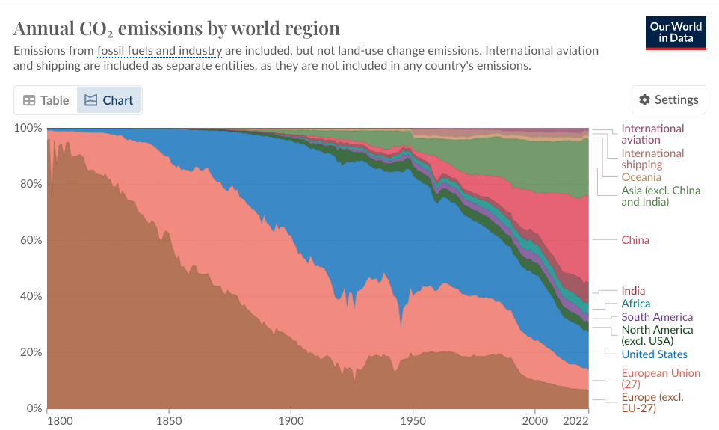
Carbon dioxide data
https://ourworldindata.org/co2-emissions
Notes:
we’ll demonstrate how to set up search alerts for queries in databases
Also run through a few searches in these
Mostly focusing on SciFinder

Slide 16
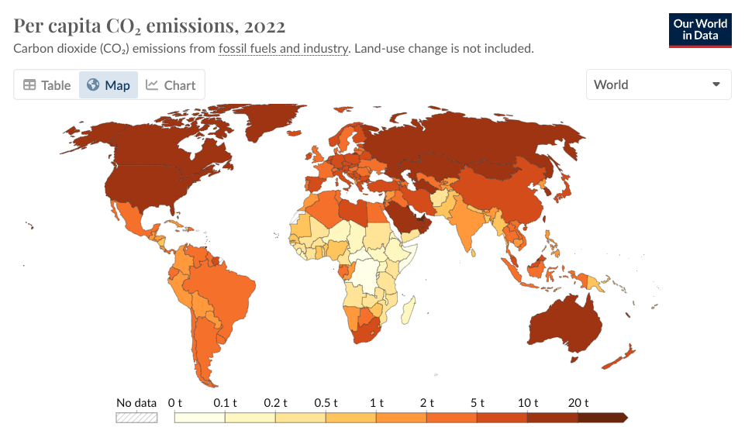
Carbon dioxide data
https://ourworldindata.org/co2-emissions
Notes:
we’ll demonstrate how to set up search alerts for queries in databases
Also run through a few searches in these
Mostly focusing on SciFinder

Slide 17
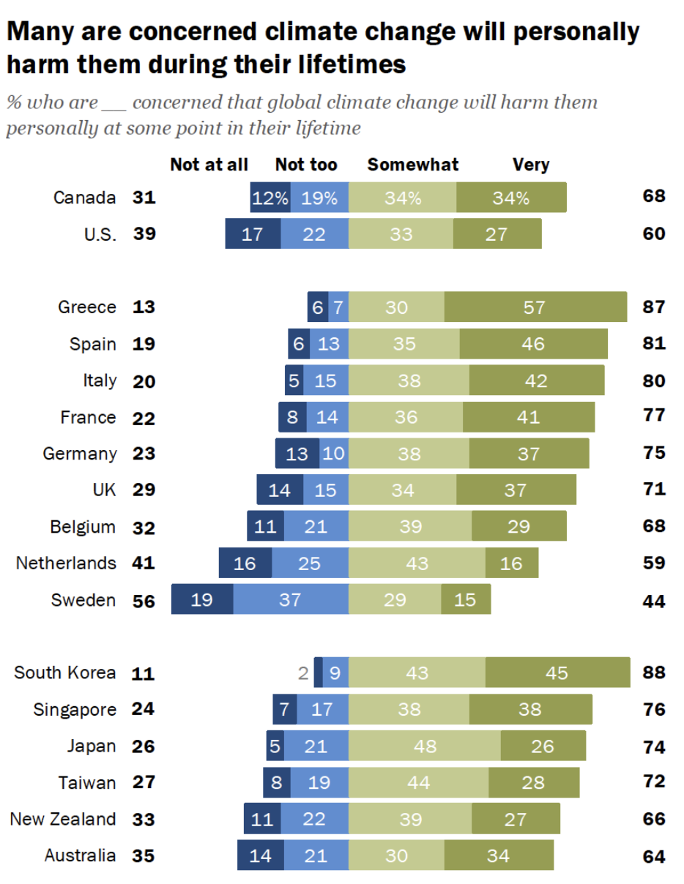
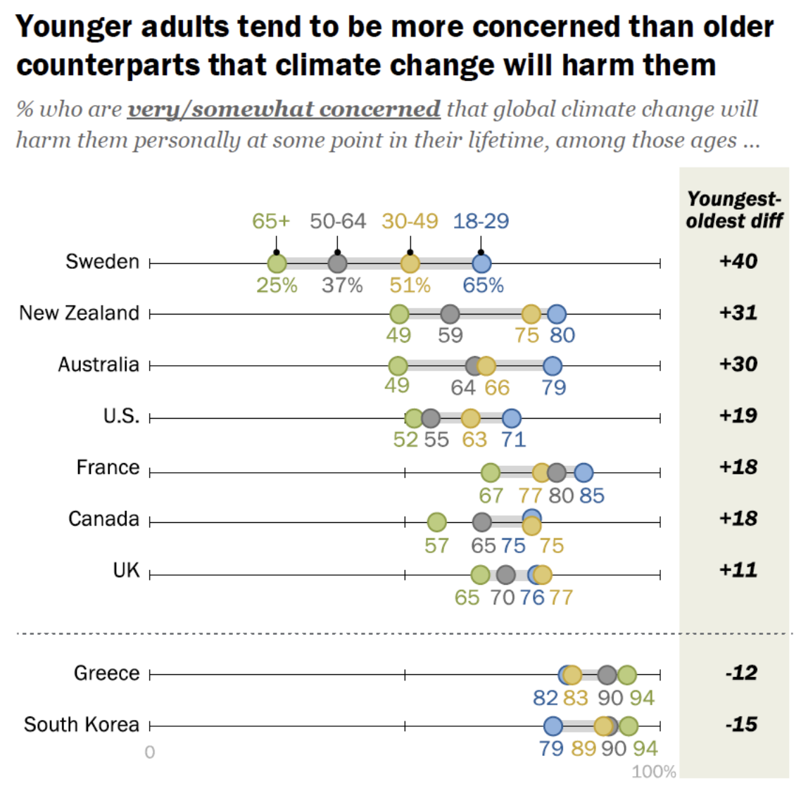
Pew climate survey
https://www.pewresearch.org/global/2021/09/14/in-response-to-climate-change-citizens-in-advanced-economies-are-willing-to-alter-how-they-live-and-work
Notes:
we’ll demonstrate how to set up search alerts for queries in databases
Also run through a few searches in these
Mostly focusing on SciFinder

Slide 18
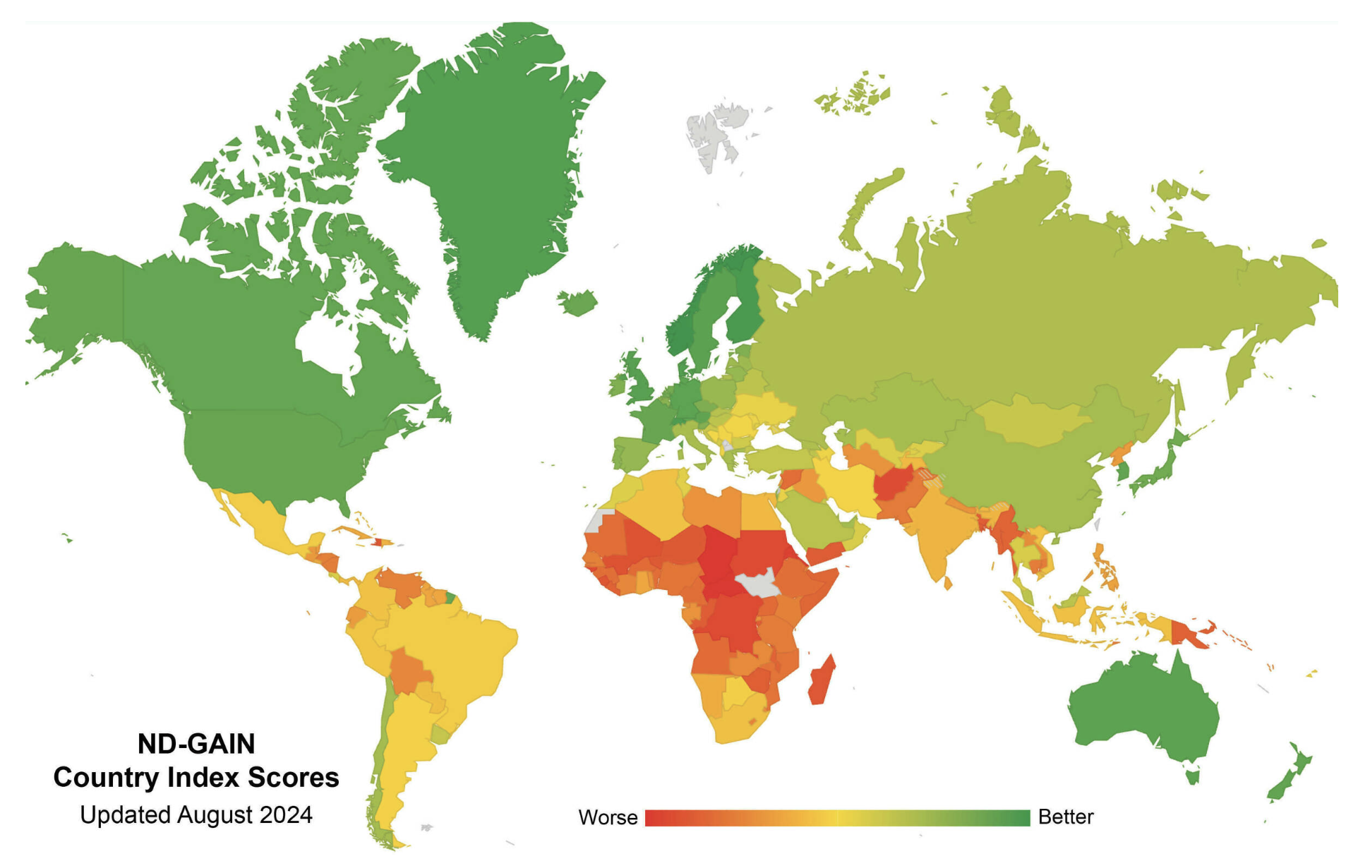
Notre Dame Global Adaptation Initiative
The ND-GAIN Country Index summarizes a country's vulnerability to climate change and other global challenges in combination with its readiness to improve resilience. It aims to help governments, businesses and communities better prioritize investments for a more efficient response to the immediate global challenges ahead.
https://gain.nd.edu/our-work/country-index
Notes:
we’ll demonstrate how to set up search alerts for queries in databases
Also run through a few searches in these
Mostly focusing on SciFinder

Slide 19
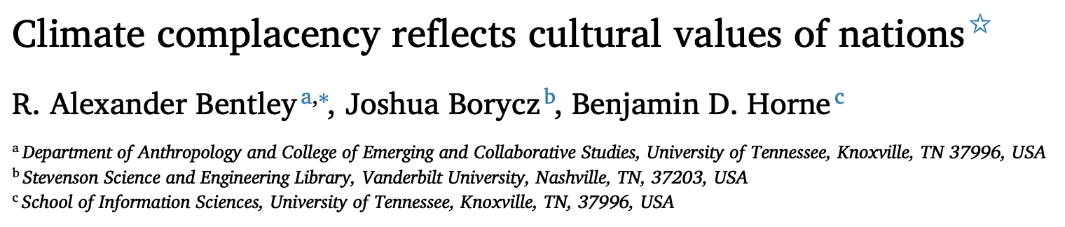
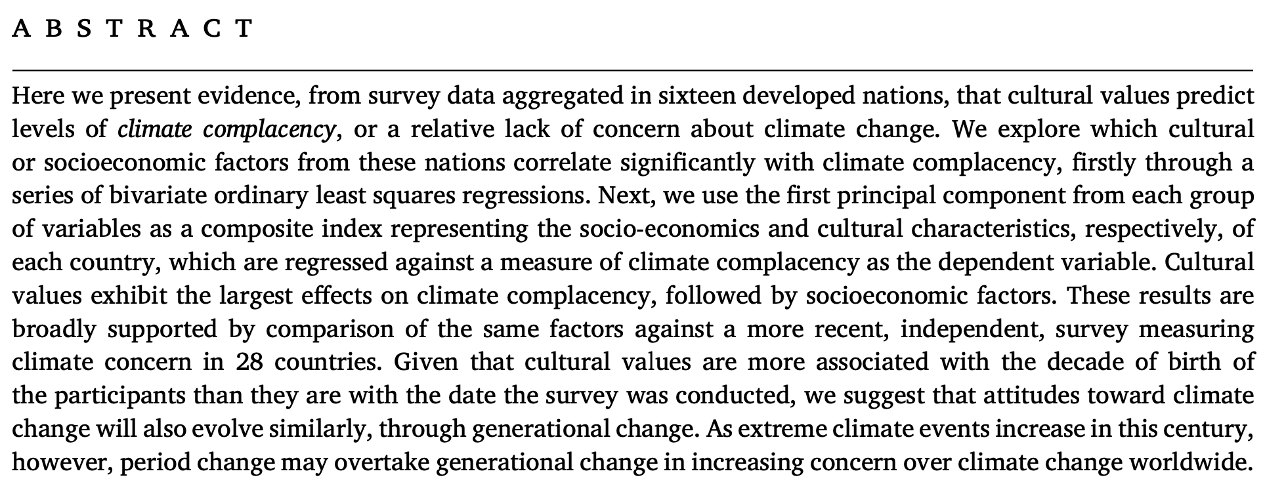
Climate complacency and culture
https://doi.org/10.1016/j.cresp.2023.100137
Notes:
we’ll demonstrate how to set up search alerts for queries in databases
Also run through a few searches in these
Mostly focusing on SciFinder

Slide 20
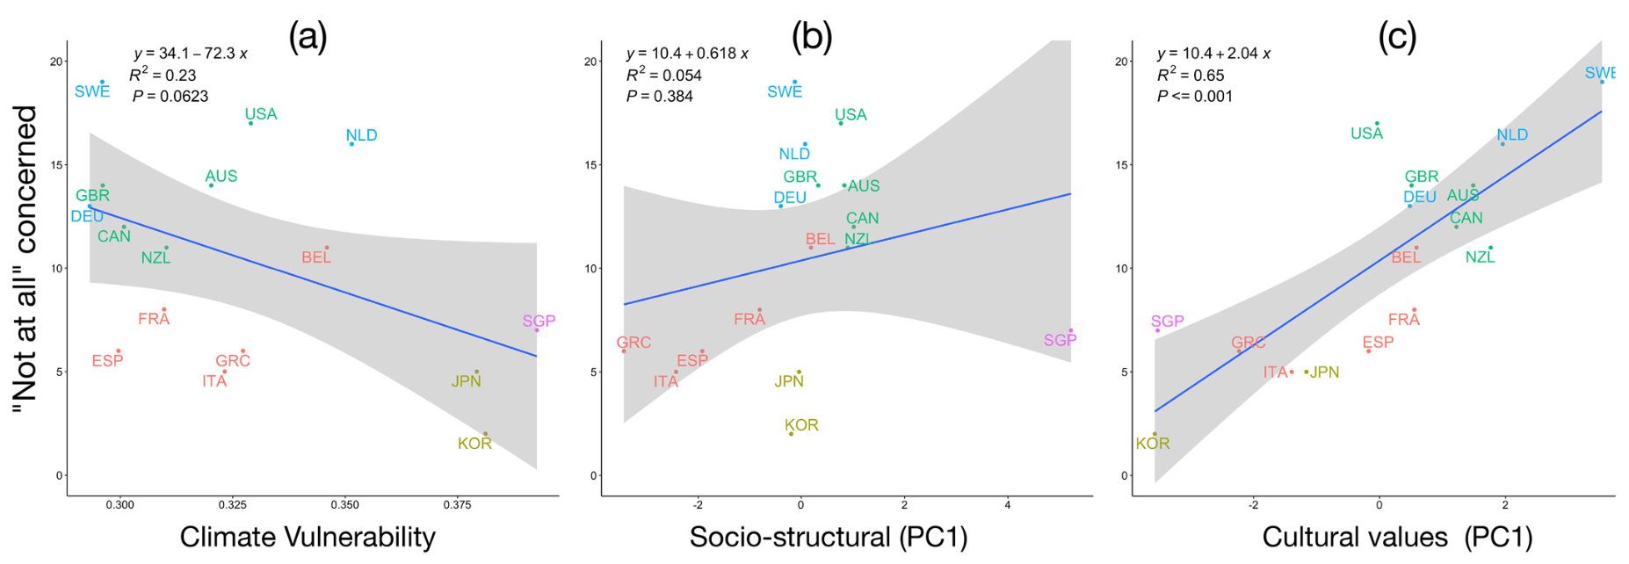
Climate complacency and culture
https://doi.org/10.1016/j.cresp.2023.100137
Notes:
we’ll demonstrate how to set up search alerts for queries in databases
Also run through a few searches in these
Mostly focusing on SciFinder

